Slide 1
https://www.storydoc.com/f2643301b1e73e64139dba6128275fb6/162feff1-4f46-49f8-9299-338a57611e5a/672df315fb98db8723d9082f

Slide 2


Slide 3


Slide 4
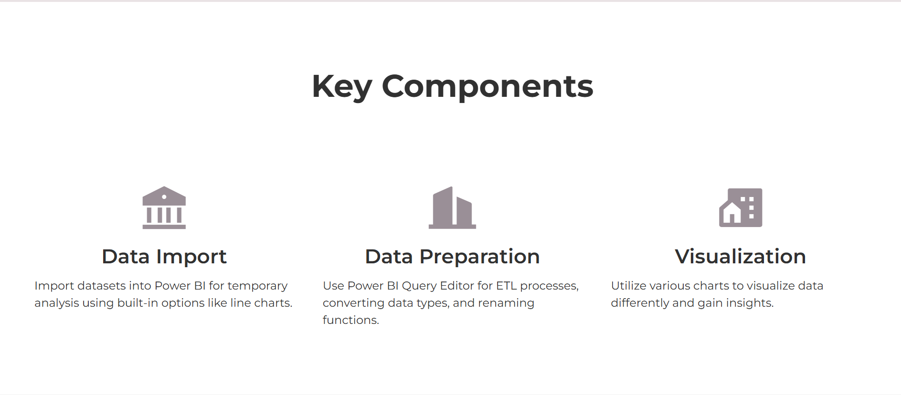

Slide 5


Slide 6
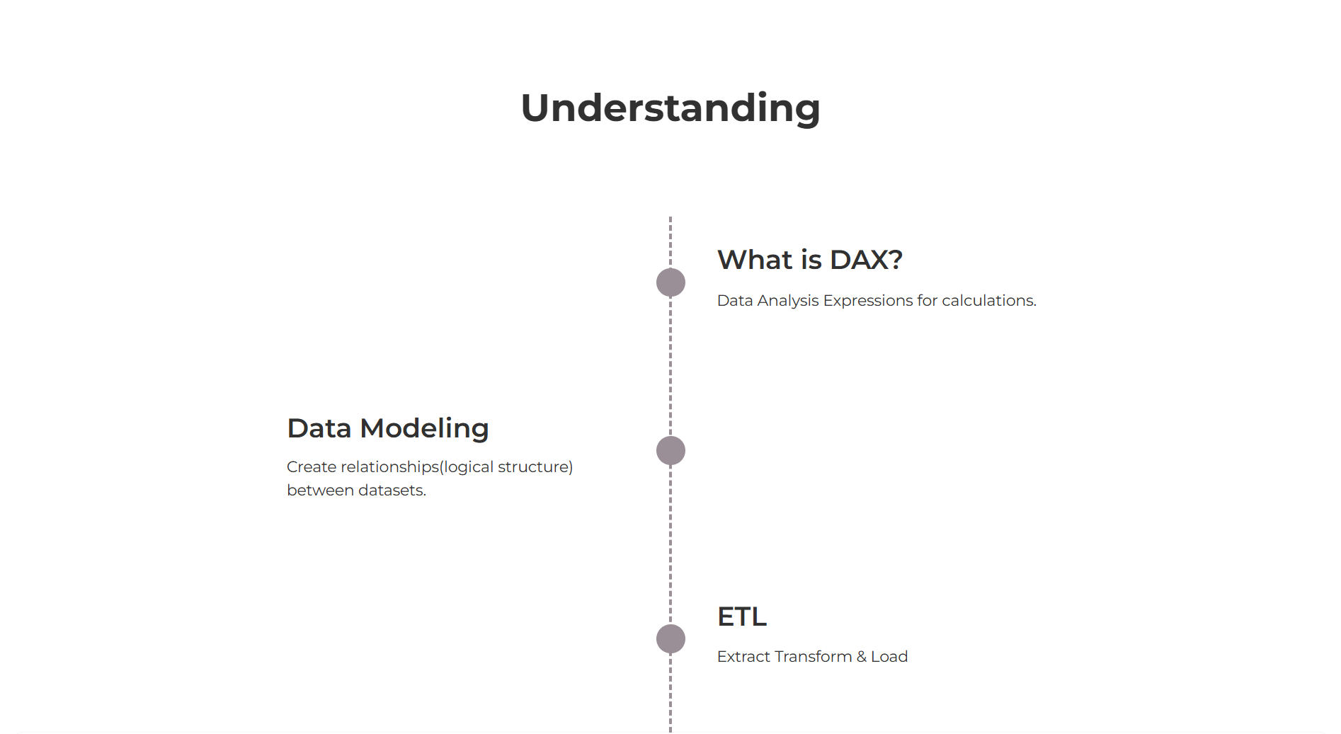

Slide 7
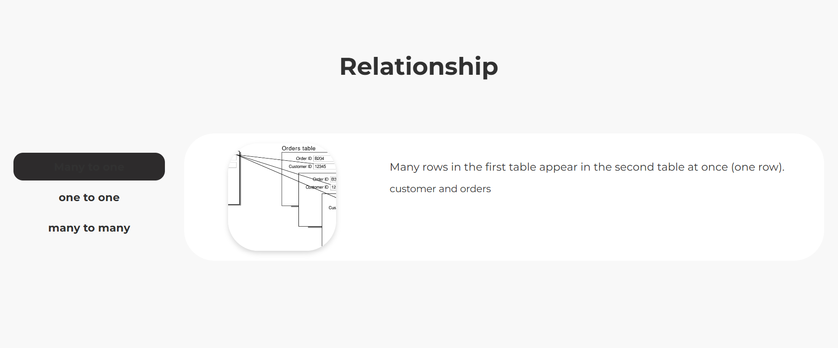

Slide 8
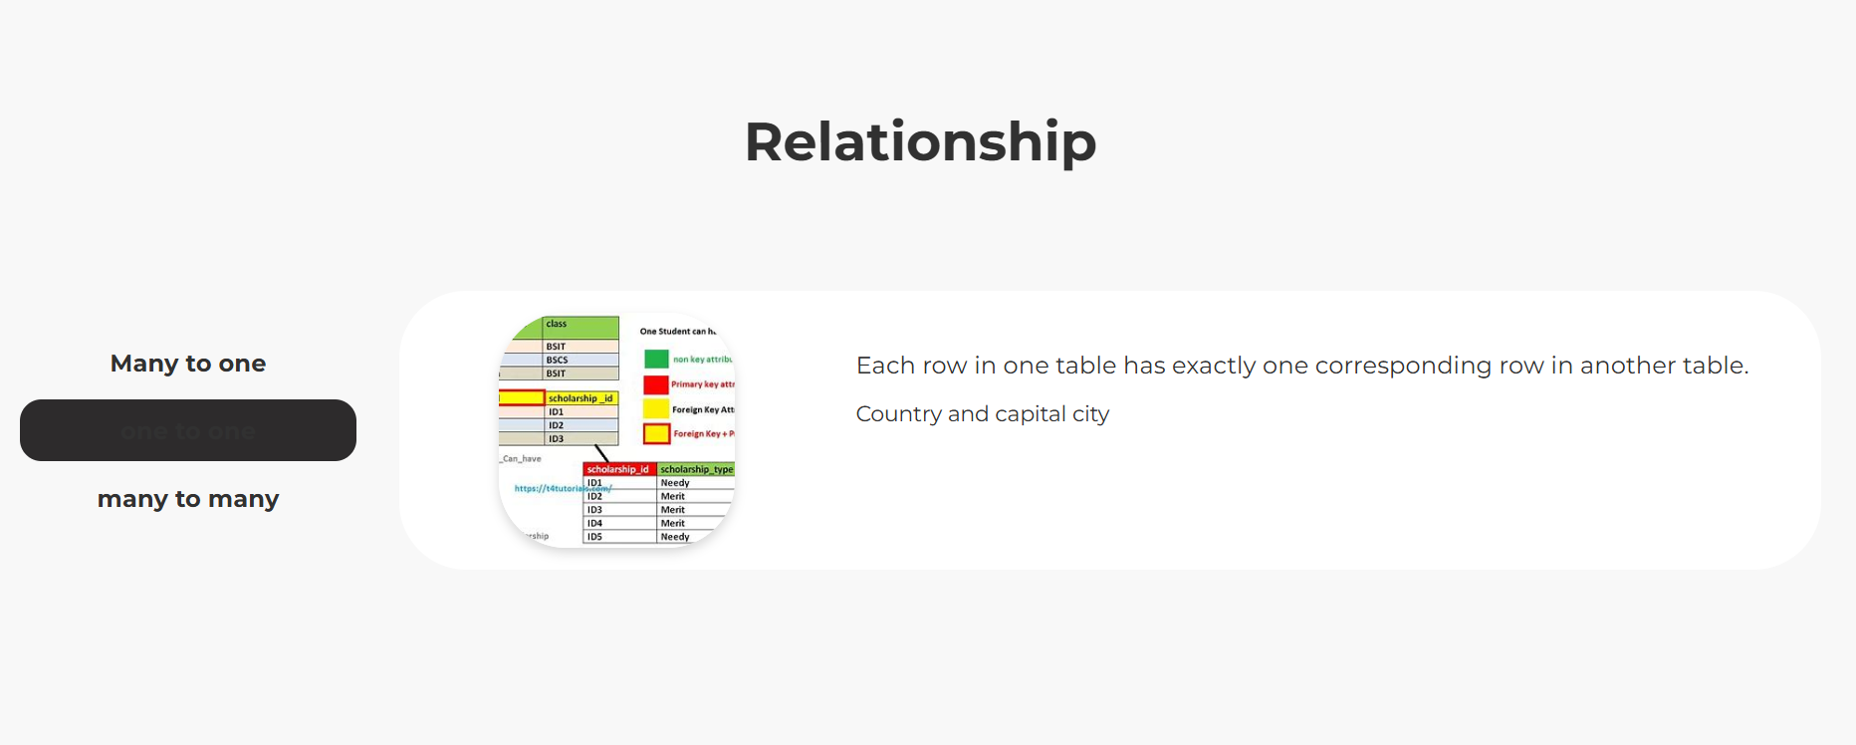

Slide 9
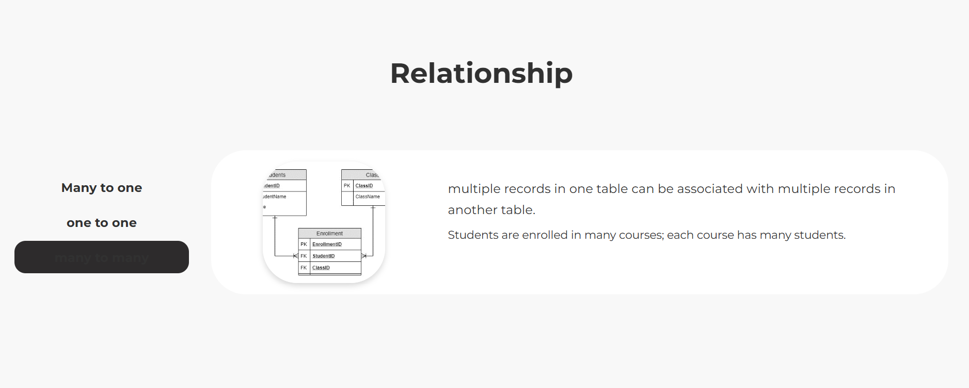

Slide 10
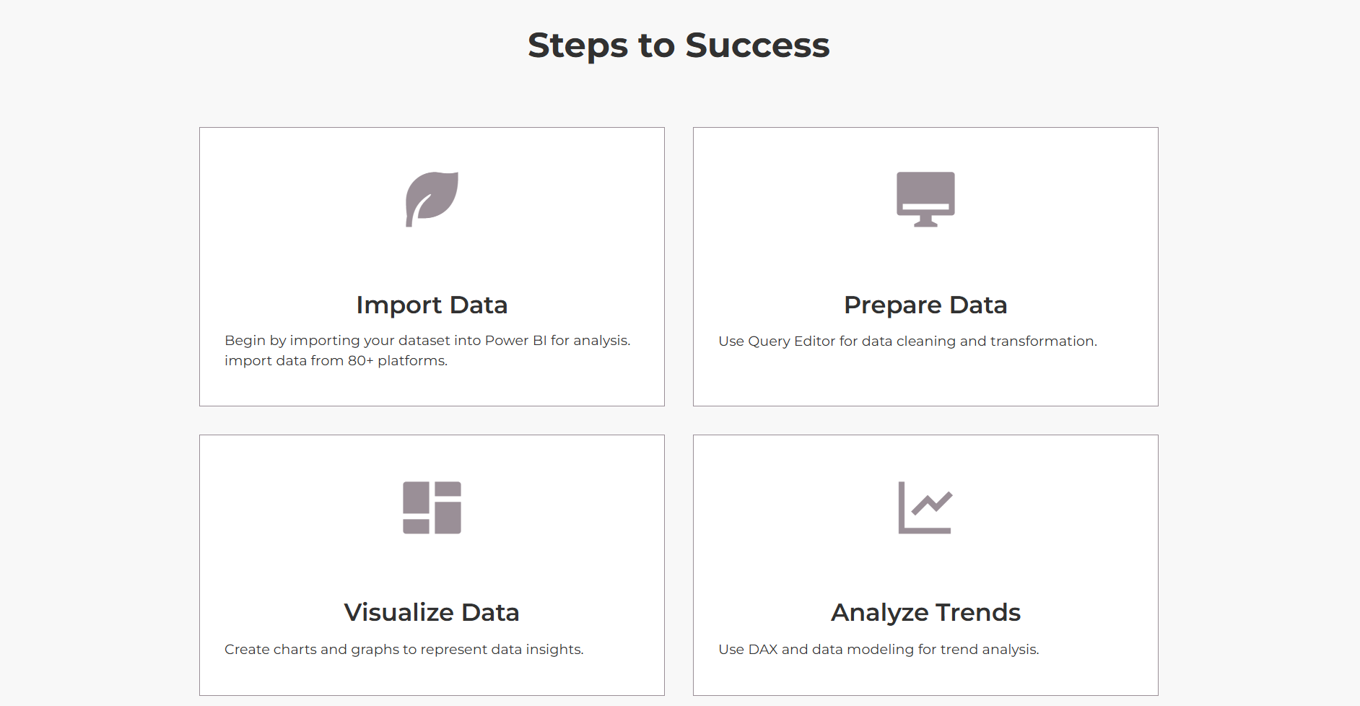

Slide 11
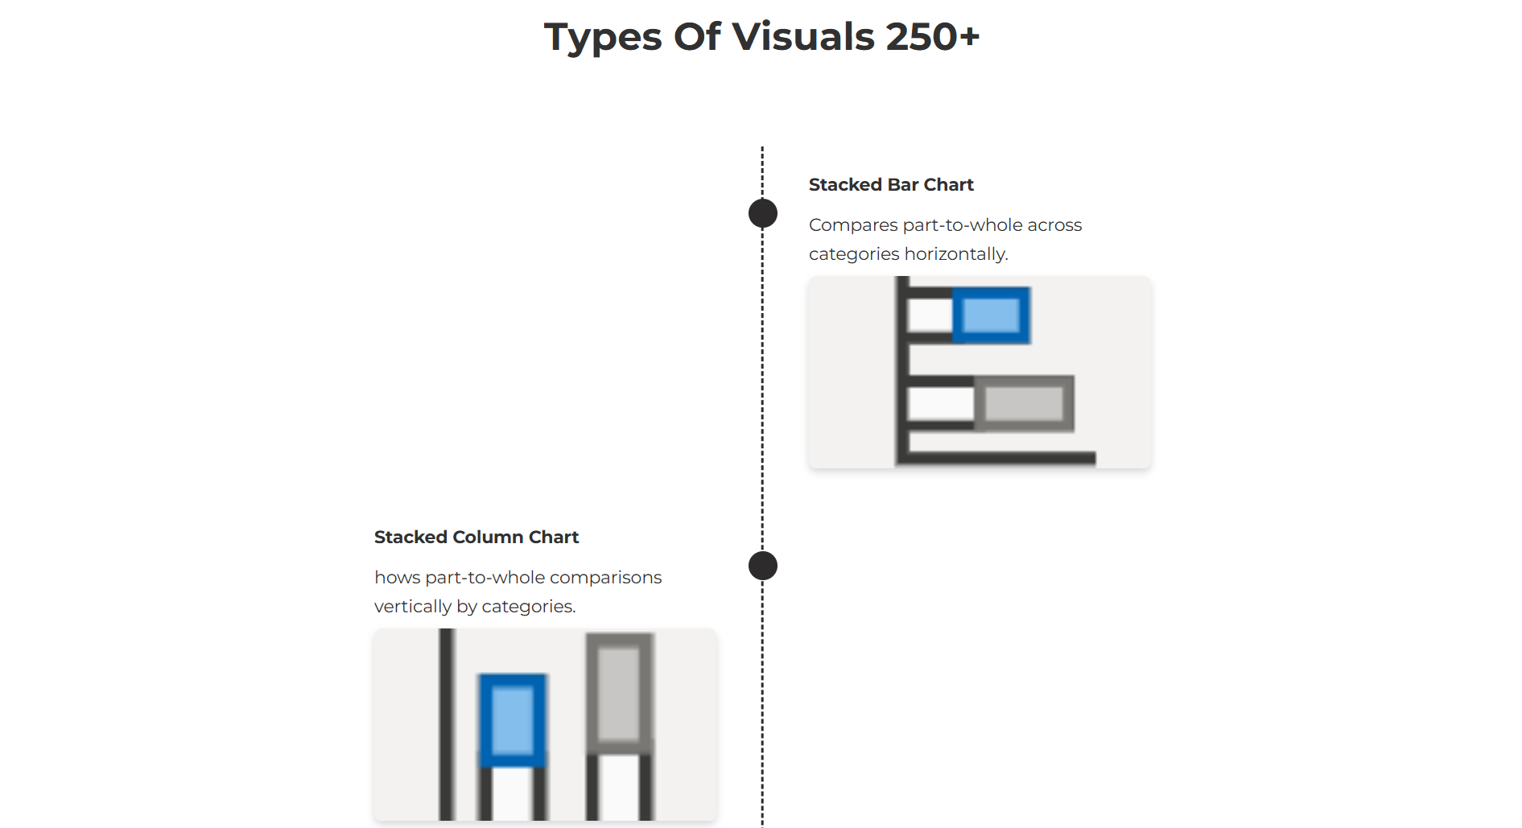

Slide 12
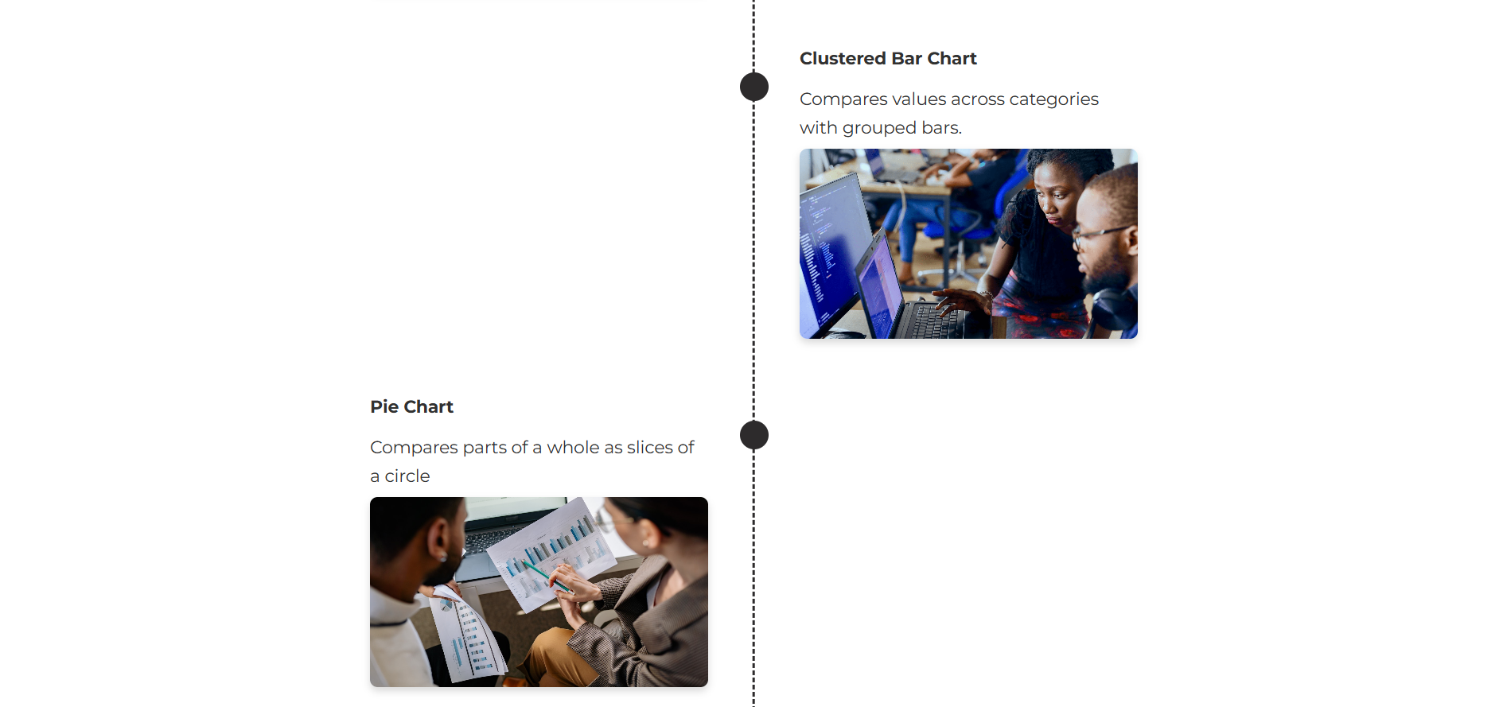

Slide 13
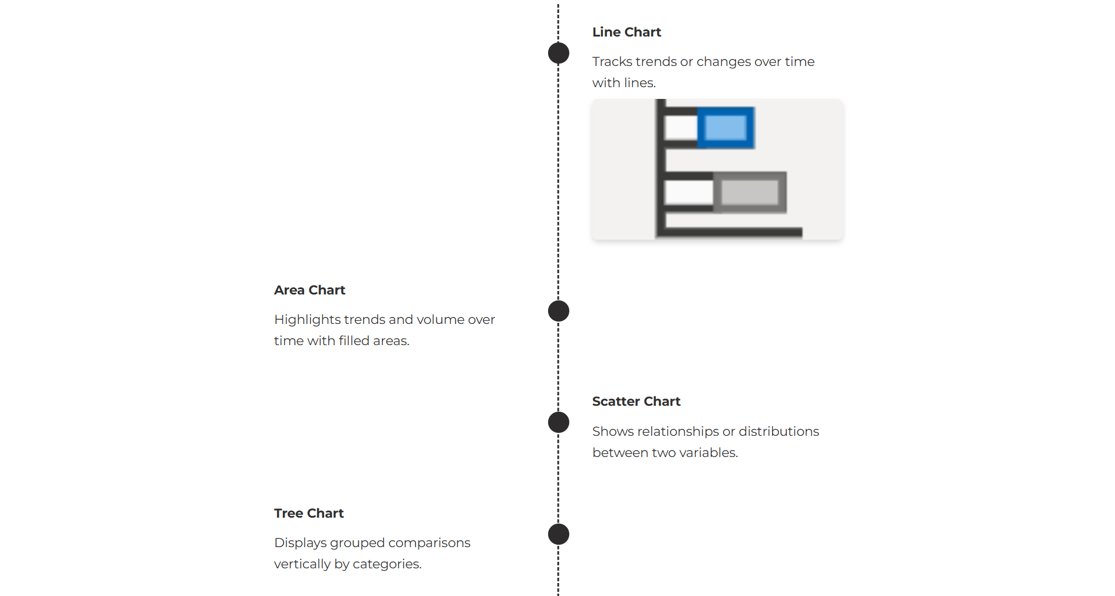

Slide 14


Slide 15


Slide 16


